Slide 1

Demographic and socioeconomic factors predict suicide rate
David Salkoff
December 7, 2019

Slide 2
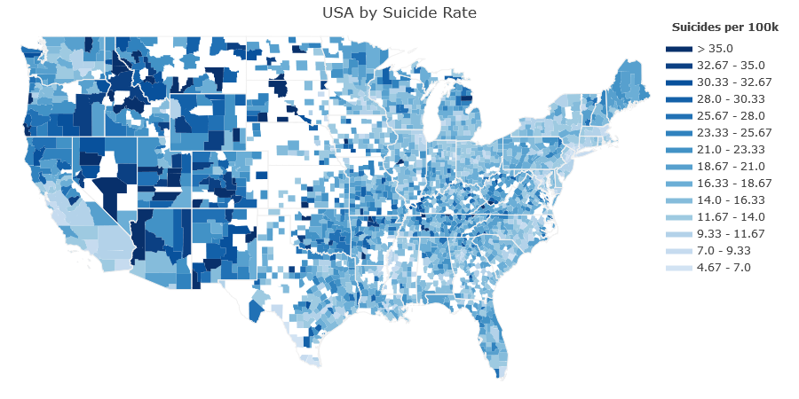
Suicide Rates vary widely across the U.S.
Source: Center for Disease Control and Prevention:
Mortality - underlying cause of death (2017)

Slide 3
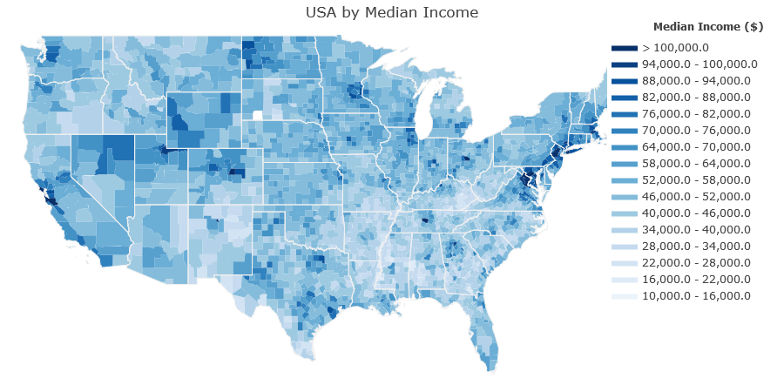
Can socioeconomic factors predict suicide rates?
Source: U.S. Census ACS 5-year, 2013-2017

Slide 4
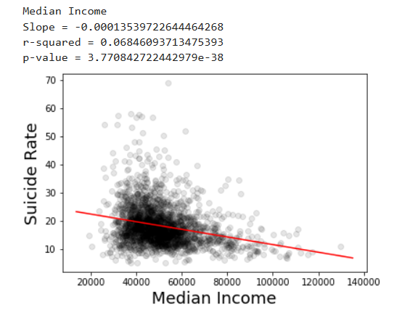
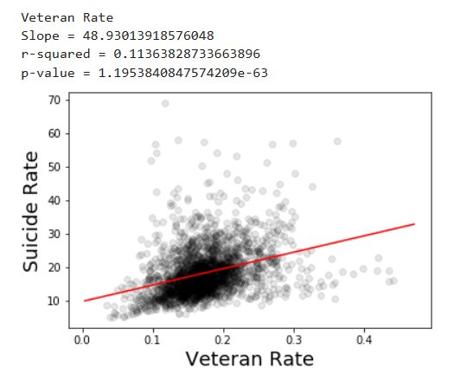
Investigating factors one-by-one…

Slide 5
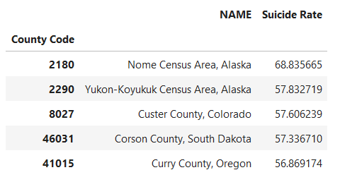
Counties with highest suicide rate offer clues

Slide 6
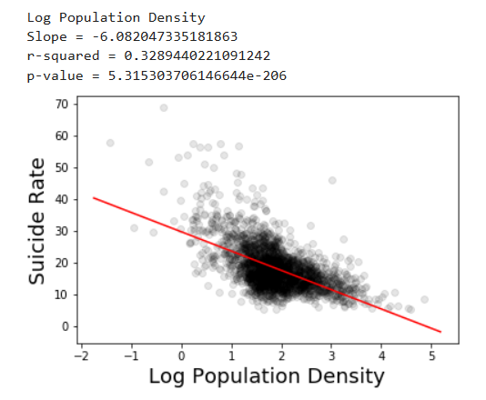
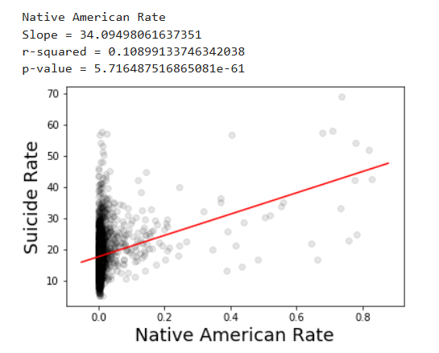
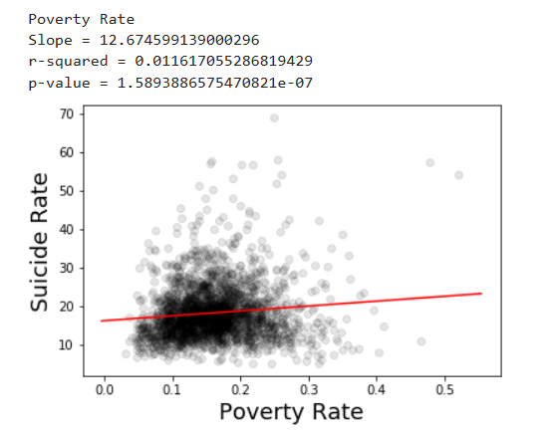
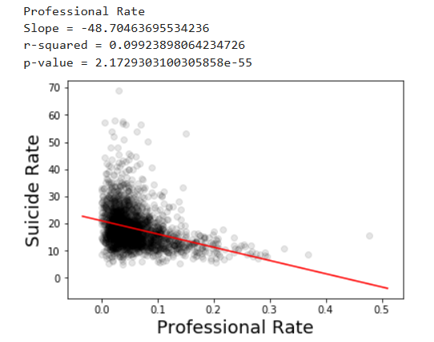
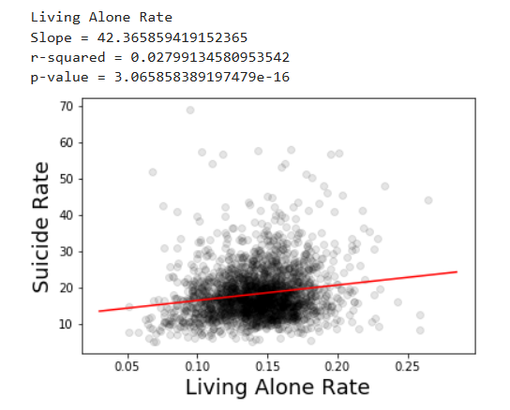
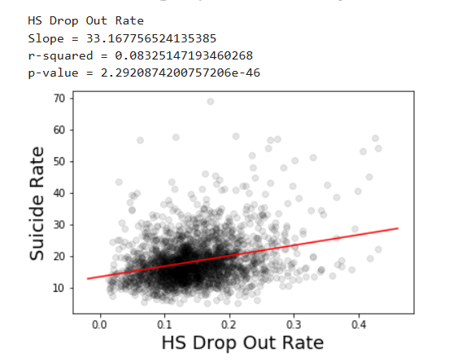
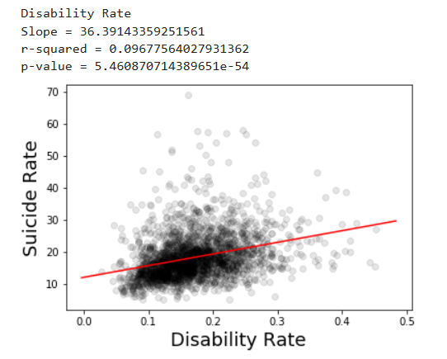
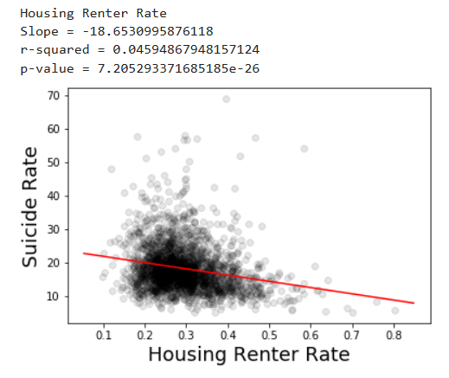
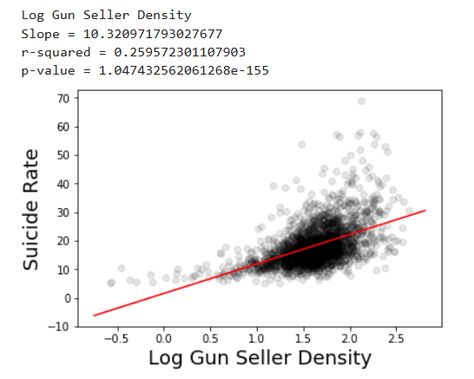

Slide 7
Factors investigated:
High School Drop-out rate
Unemployment rate
Health insurance coverage
Poverty level
Veteran rate
Disability rate
Living alone
Graduate/Professional degree rate
Daylight
Income recovery after recession
Population density
Income inequality (GINI index)
Welfare (Food stamps / SNAP)
Commute time
Construction workers rate
Time leaving for work
Biking to work
Gun dealers per 100k
Native American rate
Mental health providers per 100k

Slide 8
Factors investigated (significant):
High School Drop-out rate
Unemployment rate
Health insurance coverage
Poverty level
Veteran rate
Disability rate
Living alone
Graduate/Professional degree rate
Daylight
Income recovery after recession
Population density
Income inequality (GINI index)
Welfare (Food stamps / SNAP)
Commute time
Construction workers rate
Time leaving for work
Biking to work
Gun dealers per 100k
Native American rate
Mental health providers per 100k

Slide 9
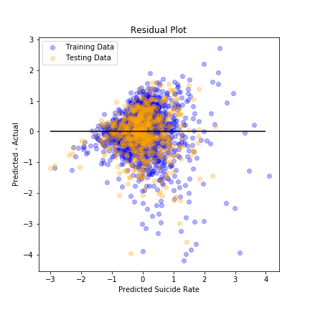
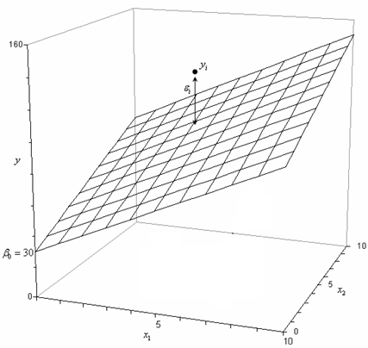
Multiple regression model

Slide 10
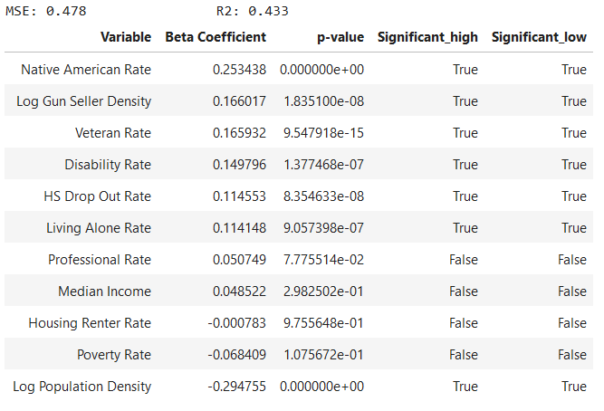
Multiple regression model results
MSE: 0.478
R2: 0.433

Slide 11
Multiple regression model results
MSE: 0.478
R2: 0.433

Slide 12
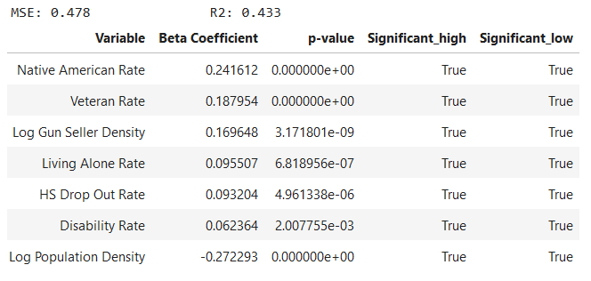
Multiple regression model (reduced)
MSE: 0.478
R2: 0.433

Slide 13
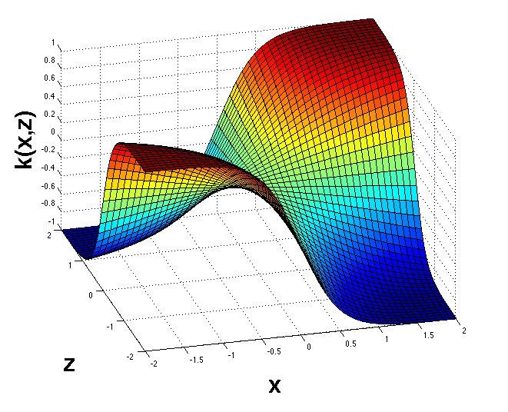
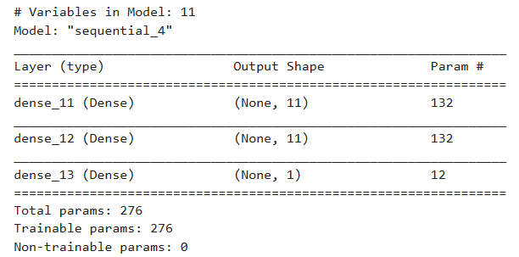
Can a neural network predict suicide rates better than multiple regression?
?
activation='sigmoid'

Slide 14
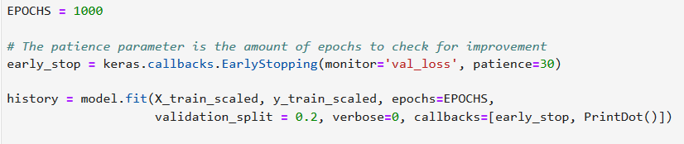
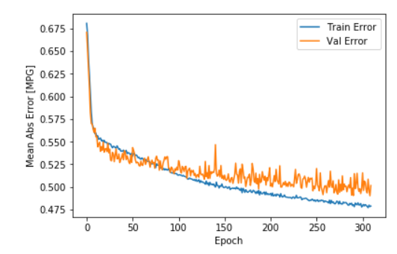
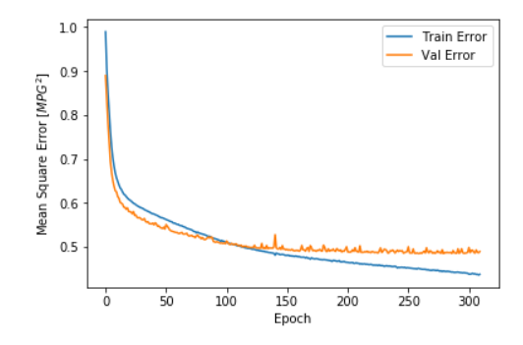
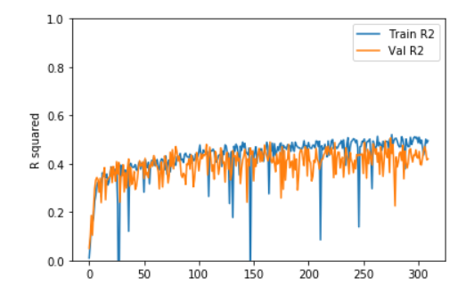
Neural network training

Slide 15
Model Comparison (test data)
Model | R-squared
Multiple Regression | 0.433
Neural Network | 0.384
✓

Slide 16
Conclusion
Many demographic, socioeconomic factors can predict county suicide rate.

Slide 17
Conclusion
Many demographic, socioeconomic factors can predict county suicide rate.
A multiple regression model can account for 43% of suicide rate variance.
Variables with p<0.05 in pair-wise correlation are not necessarily significant in a multiple regression model (e.g. median income).

Slide 18
Conclusion
Many demographic, socioeconomic factors can predict county suicide rate.
A multiple regression model can account for 43% of suicide rate variance.
Variables with p<0.05 in pair-wise correlation are not necessarily significant in a multiple regression model (e.g. median income).
Neural networks do not necessarily perform better than linear models.

Slide 19
Conclusion
Many demographic, socioeconomic factors can predict county suicide rate.
A multiple regression model can account for 43% of suicide rate variance.
Variables with p<0.05 in pair-wise correlation are not necessarily significant in a multiple regression model (e.g. median income).
Neural networks do not necessarily perform better than linear models.
Sometimes searching for more variables (features) is more important than tweaking the model.

Slide 20
Conclusion
Many demographic, socioeconomic factors can predict county suicide rate.
A multiple regression model can account for 43% of suicide rate variance.
Variables with p<0.05 in pair-wise correlation are not necessarily significant in a multiple regression model (e.g. median income).
Neural networks do not necessarily perform better than linear models.
Sometimes searching for more variables (features) is more important than tweaking the model.
Future: Find more variables, isotonic regression.

Slide 21
Thank you!

